Slide 1




Password Cracking
Directory, Rainbow Table, Online Cracking
By Deano B00091839@student.itb.ie

Slide 2

!!! WARNING !!!
I and the Hacker Soc will not be responsible for your mistakes or actions with the information you will learn from this or any talks or workshops you participate in.

Slide 3
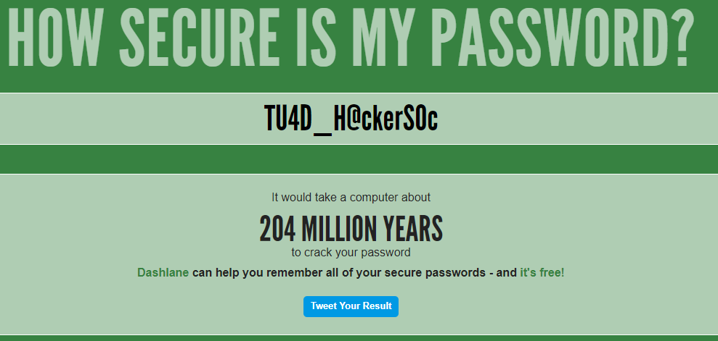
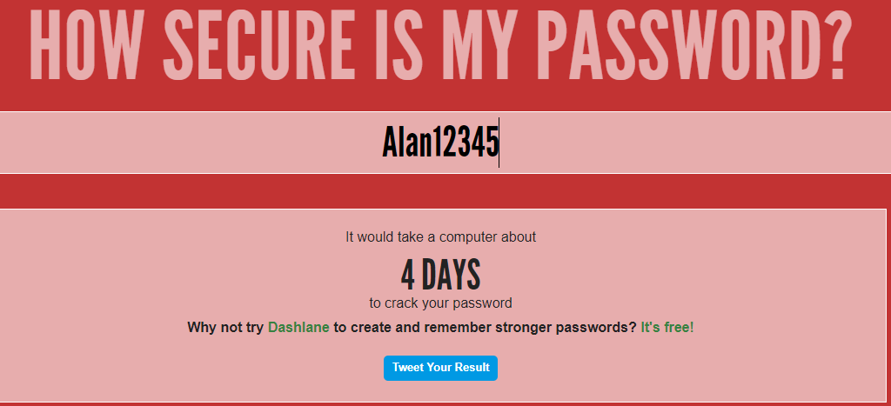
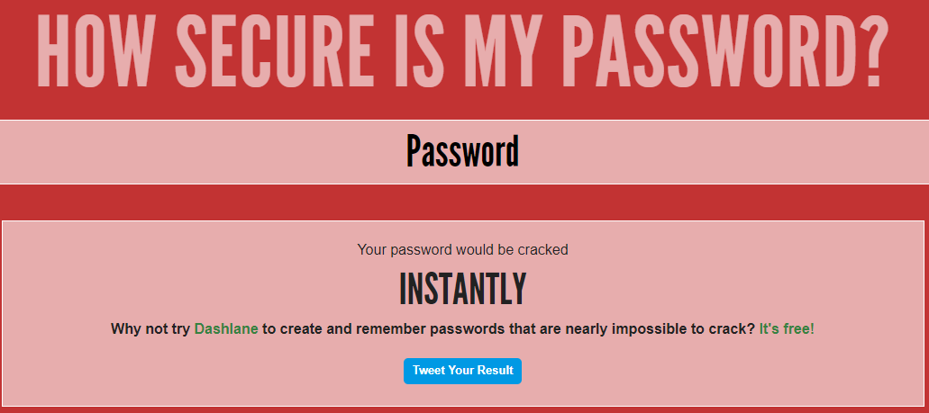
Types of Passwords
The Good
The Bad
The Sad
“and the password
Used by your Dad”
Recommended
Uncommon Words
Special Characters
Numbers
Over 10 Numbers
Something you can
Remember
Or
Use LastPass

Slide 4

Types of Encryption Used
Common used Encryption Types
1 – 3DES
2 – RSA
3 – BlowFish
4 - TwoFish
5 – AES
6 – MD5
7 – SHA 1 OR 256 OR 512
8 – NTLM
9 – Base64

Slide 5
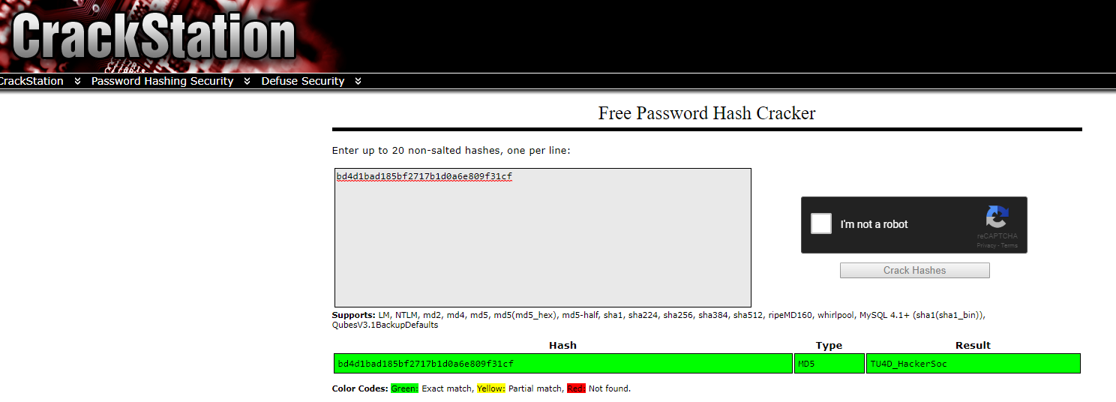
Online Cracking
If you don't have the power to run a password cracking process on your machine then it's best to try to see if that password was already cracked online somewhere.
Google- Sometimes the cracked password is simply a Google search away, for example if you search for dab64765f3d4fc29ced777be274337ea (MD5 hash) then you'll find that it was already cracked somewhere and the plain-text for it is : hacking
crackstation.net- the website supports the following hashing algorithms : LM, NTLM, md2, md4, md5, md5(md5_hex), md5-half, sha1, sha224, sha256, sha384, sha512, ripeMD160, whirlpool, MySQL 4.1+ (sha1(sha1_bin)), QubesV3.1BackupDefaults .
Google is your friend and you'll find a lot more websites that will help you crack passwords online and sometimes by request with a simple email

Slide 6
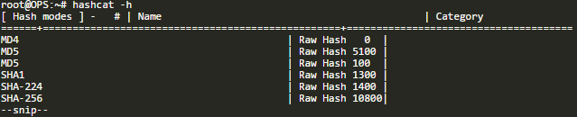
Dictionary Based
Since the hashes we normally deal with during a pentest are one-way (meaning the algorithm encrypts the text provided to it but there is no way to decipher it) so the only way is to encrypt a list of common passwords using the same algorithm then run a comparison for each result against the original hash and see if it matches then we can deduce the original text used.
There are lots of tools that can do Dictionary Based cracking and the most popular one is hashcat and it is pre-installed in Kali Linux.
Running hashcat -h will give you the full list of available options, and you'll see that it's capable of cracking almost all types of hashes

Slide 7
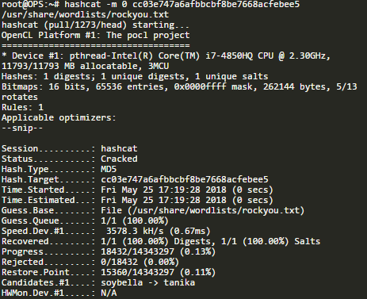
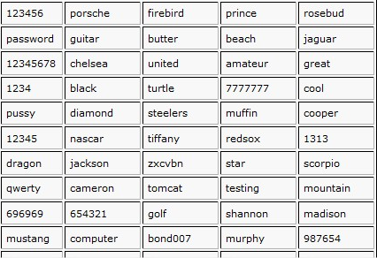
Dictionary With Hashcat
For the sake of demonstration we'll assume that we captured the following MD5 hash during a pentest cc03e747a6afbbcbf8be7668acfebee5 , Now we run the following command against it to try and crack it using the rockyou.txt wordlist
As you can see the hash was cracked only after a few seconds and the plain-text is test123

Slide 8
Where to get Wordlists
Google
Leaked Documents
Hand Write them yourself
Generate with a tool like Crunch

Slide 9
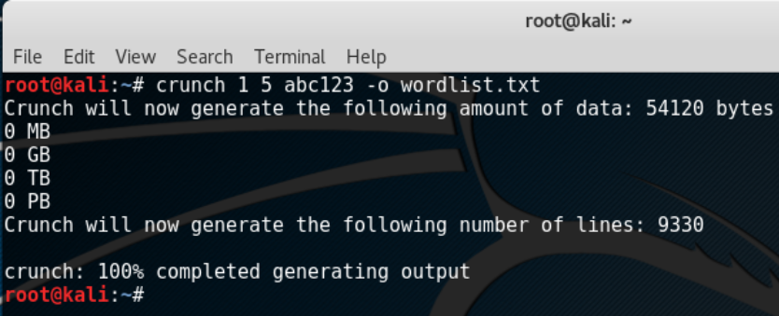
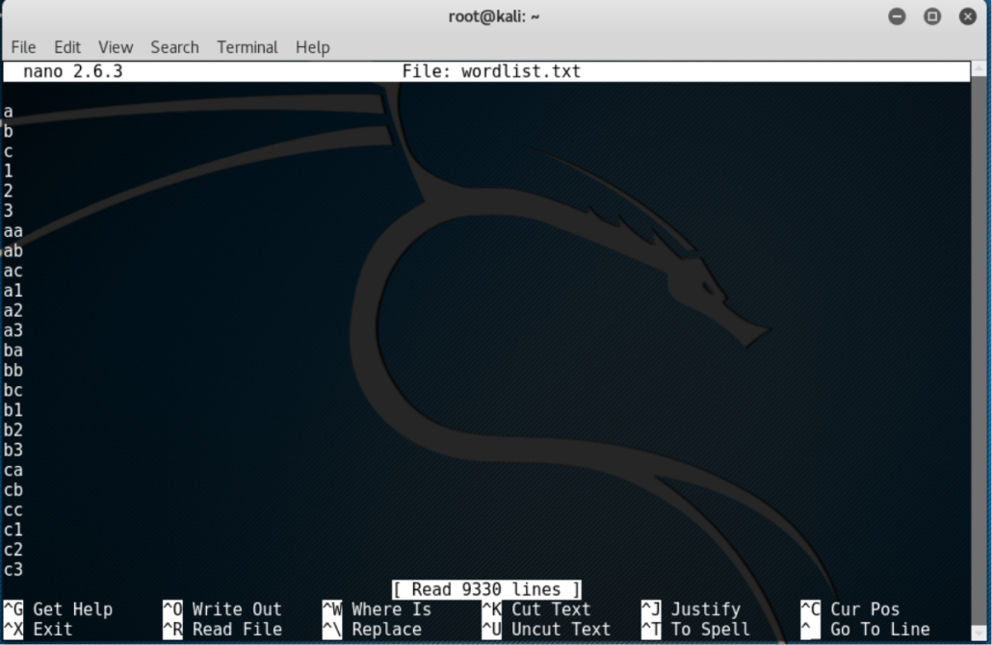
Making a Wordlist with Crunch
Crunch is the Most Common tool used
Crucnh works with crunch [min length] [max length] [charset/options]
We will use the command crunch 1 5 abc123 –o wordlist.txt
The Output of this is a text
Document like so →

Slide 10
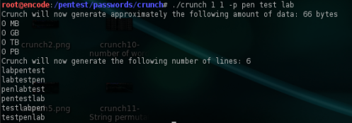
Crunch Worldlist with Known Data
This is useful if you know they like something such as a puppy, food or service
Crunch 1 1 –p pen test lab

Slide 11
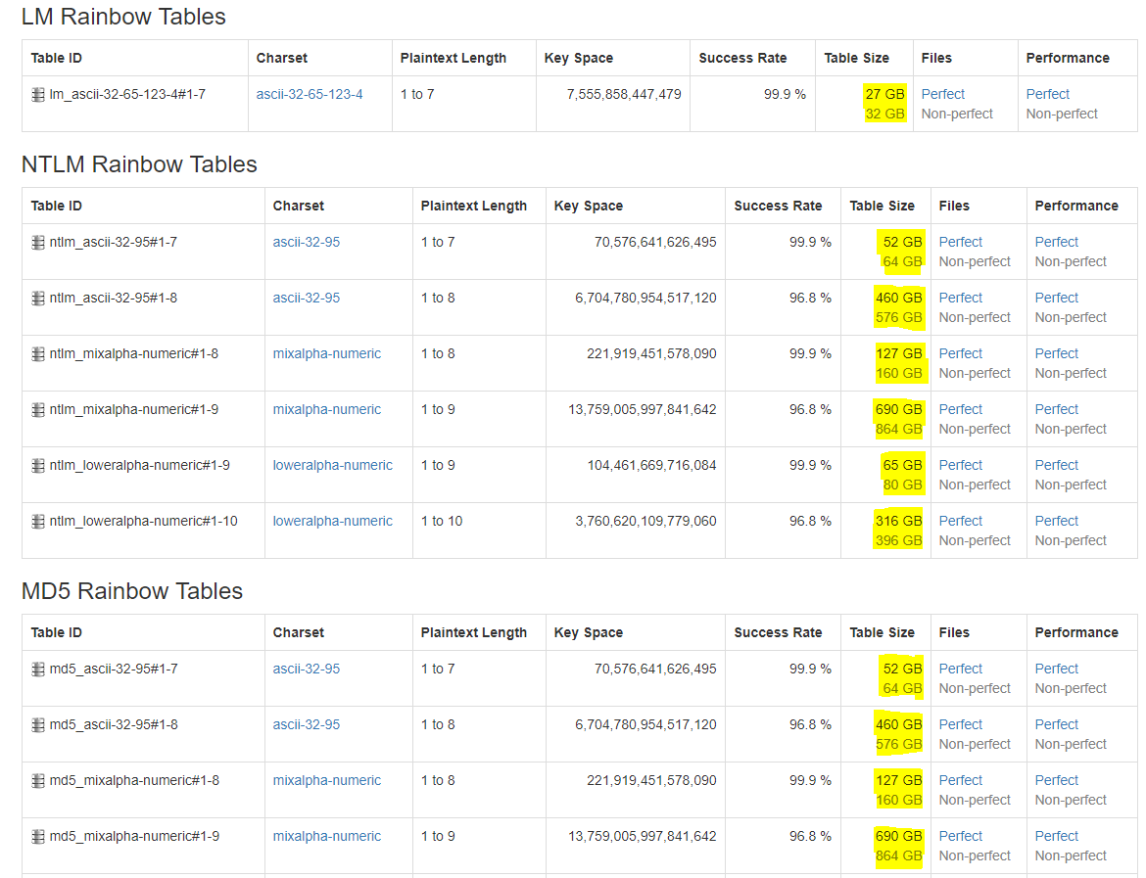
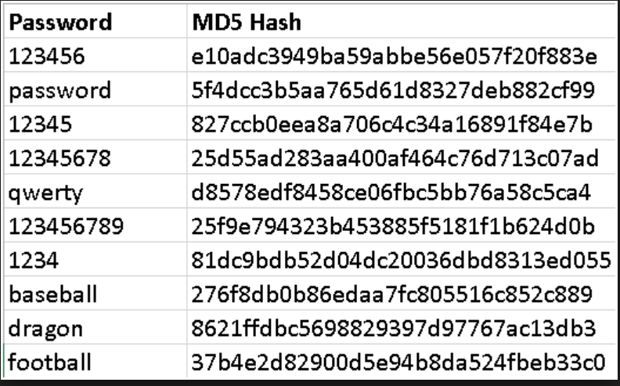
Rainbow Table
A Rainbow Table is premade table of every possible hash combination of a set list or even every word in the English dictionary, that the hash is then compared against … The Downside is usually the size of these lists and power to build
For more info checkout
http://project-rainbowcrack.com

Slide 12
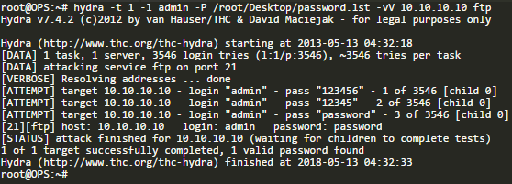


Brute forcing FTP Password
For Demo – FTP we know IP of and a password list we made on this target
We use the tool Hydra with the command
Hydra –t [time] –l [username] –P [password file] –vV [IP] FTP
Its quick the password is “password”

Slide 13
Real World
During and attack Hiding the File type commonly is important i.e spoofing a .exe file as a .pdf or .doc this is known as Crypting using a tool called a Cryptor
Base64 is pretty common when attacking PHP websites, as some offer executing the Base64 code without taught while checking PHP pages for strange code

Slide 14
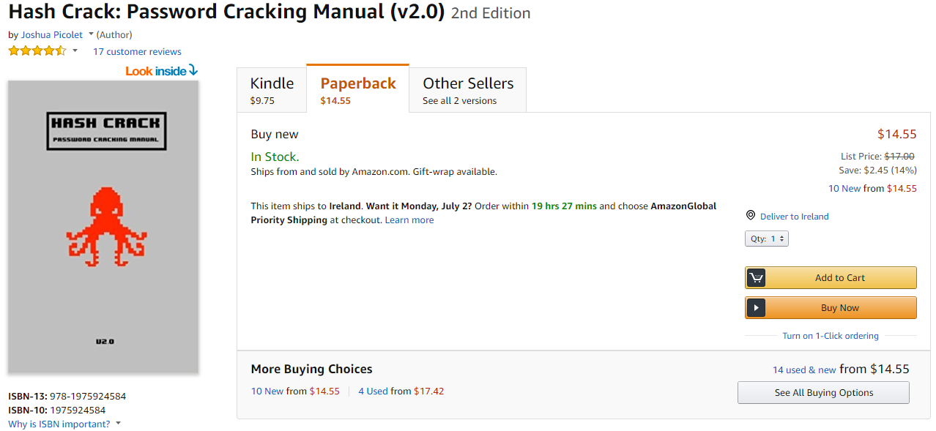
Recommended Reading For More Info

Slide 15


